Slide 1


For Beginners!
© Copyright Matthew Flood, 2022

Slide 2
For Beginners!
Week 4:
What is a function?
Function arguments
What is a composite type (Struct)?
Struct methods

Slide 3


What is a function?
Functions in programming are analogous to functions in mathematics:
y = f(a,b,c,…)
x, y, z, … = f(a)
In simple terms, they are a shorthand way to perform a series of commands that produce a desired output or perform a certain task.
Functions can (in theory) take any number of inputs and return any number of outputs.
Functions in Julia are highly composable, meaning that they can perform different jobs depending on the type of inputs given to them.

Slide 4


What is a function?
We have already come across many different functions so far.
X = floor(pi) # one input, one output
print(“Hello world”) # one input, no outputs
Pluto.run() # no inputs, no outputs
Y = occursin(‘u’, “Julia”) # two inputs, one output
+ or +(1,40,3.82,...) # + and * are functions, many inputs, one output
GDE, GDR, PIx, GIx, SIx, AIx = GridEn(Sig) # six outputs, one input ***

Slide 5
What is a function?
In many cases, the nature of the output can depend on the nature of the input passed to the function.
Examples: We have used the rand() function before to return random numbers:
X = rand() # returns a single random number (Float64) between 0 and 1
0.54372957249567
X = rand(1) # returns 1-element array with random number between 0 and 1
[0.49598]
X = rand(36) # returns 36-element array of random numbers between 0 and 1
[0.83951, 0.19384, 0.23587, …, 0.99349]
X = rand(1:7) # returns a randomly-chosen integer between 1 and 7
4
X = rand(18:65, 4) # returns 4-element array random integers between 18 and 65
[21, 2, 60, 47]
X = rand(“An example string”, 3) # returns 3-element array of chars in “An example string”
[‘n’, ‘ ’, ‘A’]

Slide 6
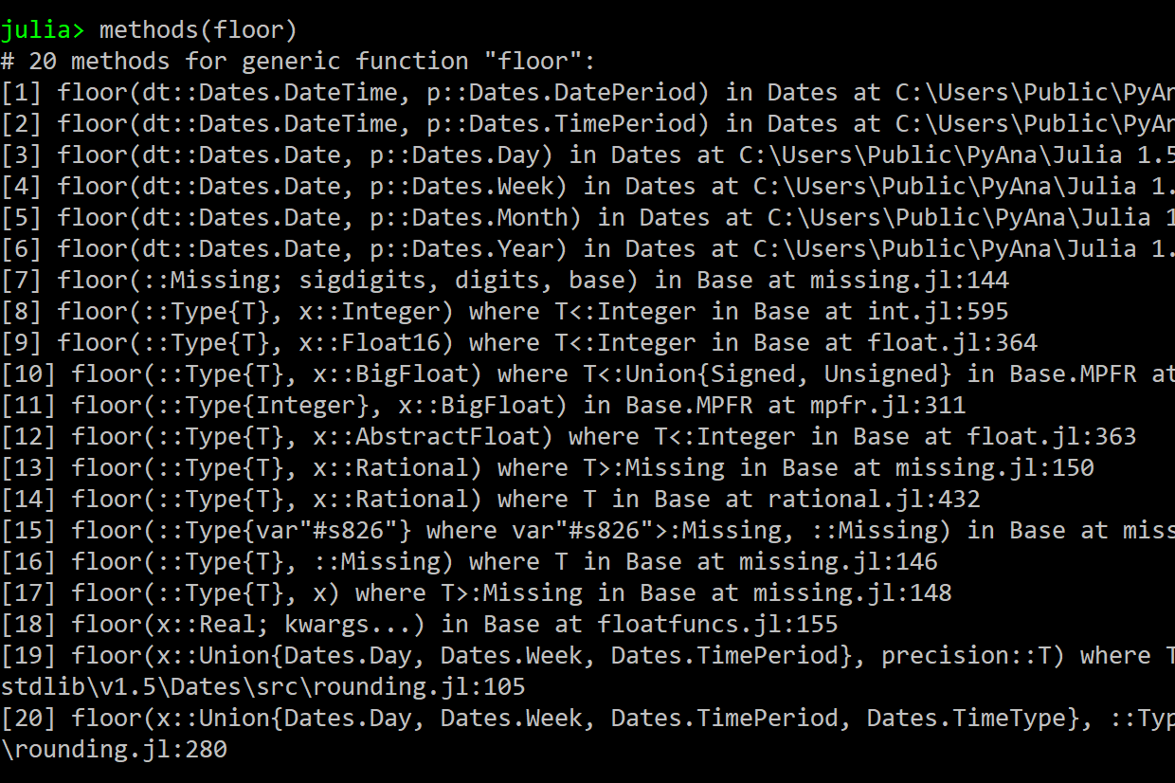
What are function methods?
What we saw in the previous slide are examples of function methods.
Function methods are the various ways in which functions manipulate and operate based on the nature of the inputs they are given.
To see the different methods a function possesses we use the methods() function:
Note: Function methods are slightly different to object methods.

Slide 7
What are function arguments?
Function inputs are mainly referred to as arguments.
We will focus on the 3 main types of function arguments:
Outputs = MyFunction(required1, required2; positional1, keyword1 = option1)
Required arguments come first in the order. These are the values and objects needed to perform the calculation in the function.
When writing a function, required arguments come first and are distinguished from others by the semicolon.
Keyword arguments are also optional arguments that can be added to the function but are not necessary.
Keyword arguments have a default value (option1) that can be changed. Multiple keyword args can be given in any order, only after the positional arguments
Positional arguments are optional additional arguments that can be used in the function but are not necessary.
Their position after the required arguments is important.

Slide 8
What are function arguments?
Example: Suppose we want a function that calculates income inequality.
result = Inequality(salaries, social_status; age_adjust, $ = true, inflation_rate = 1.234)
The $ keyword argument converts salaries to dollars by default. If the user does not want dollar conversion they would enter: $ = false.
Inflation_rate adjusts the inequality calculation based on a given rate (default = 1.234).
When calling Inequality() the order of $ and inflation_rate doesn’t matter.
Salaries and social_status are the variables (arrays or other collections) containing data about annual salaries and social status, respectively.
These are required because without them, we cannot estimate inequality. These arguments must appear first and in this order.
age_adjust is an optional positional argument. When it is entered in the function call after social_status, it updates the output (result) to adjust the inequality estimate based on the age data given by age_adjust.

Slide 9

What are function arguments?
result = Inequality(salaries, social_status)
result = Inequality(salaries, social_status; age_adjust)
result = Inequality(salaries, social_status; age_adjust, $ = true)
result = Inequality(salaries, social_status; age_adjust, inflation_rate = 1.234)
result = Inequality(salaries, social_status; inflation_rate = 1.234)
result = Inequality(salaries, social_status; $ = false)
result = Inequality(salaries, social_status; $ = true, inflation_rate = 1.001)
result = Inequality(salaries, social_status; inflation_rate = 1.234, $ = true)
result = Inequality(salaries, social_status; age_adjust, $ = true, inflation_rate = 1.5)
result = Inequality(salaries, social_status; age_adjust, inflation_rate = 0.88, $ = false)

Slide 10
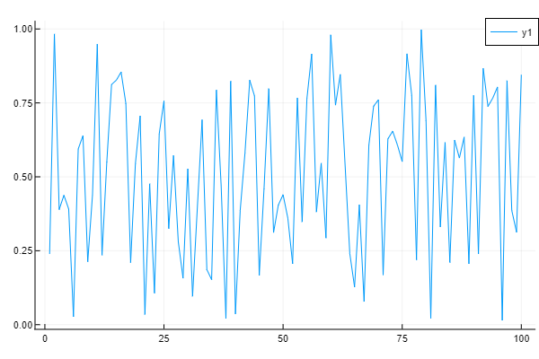
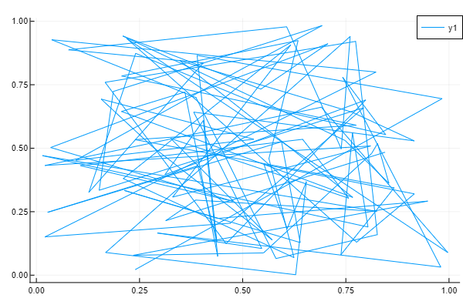
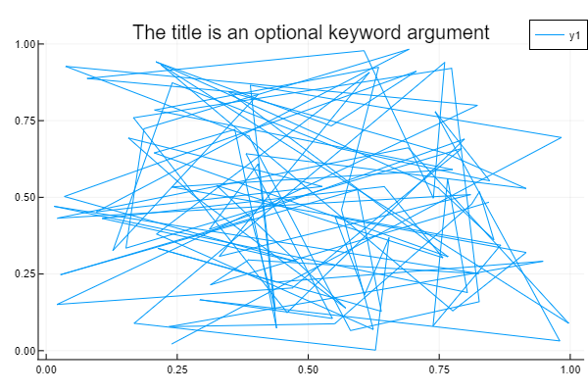
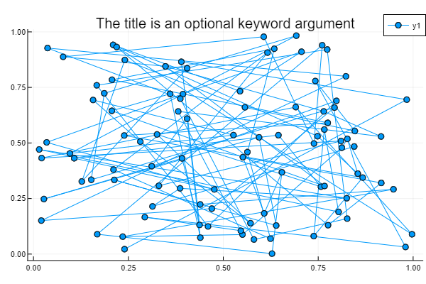
Some examples of this in action
Our old friend – plot()
julia> using Plots
julia> xdata = rand(100); ydata = rand(100)
julia> plot(xdata)
# ydata is a (optional) positional argument
julia> plot(xdata, ydata)
# title is a (optional) keyword argument
julia> plot(xdata, ydata,
title=“The title is an optional keyword argument”)
# marker is another (optional) keyword argument
julia> plot(xdata, ydata, marker=:scatter,
title=“The title is an optional keyword argument”)

Slide 11

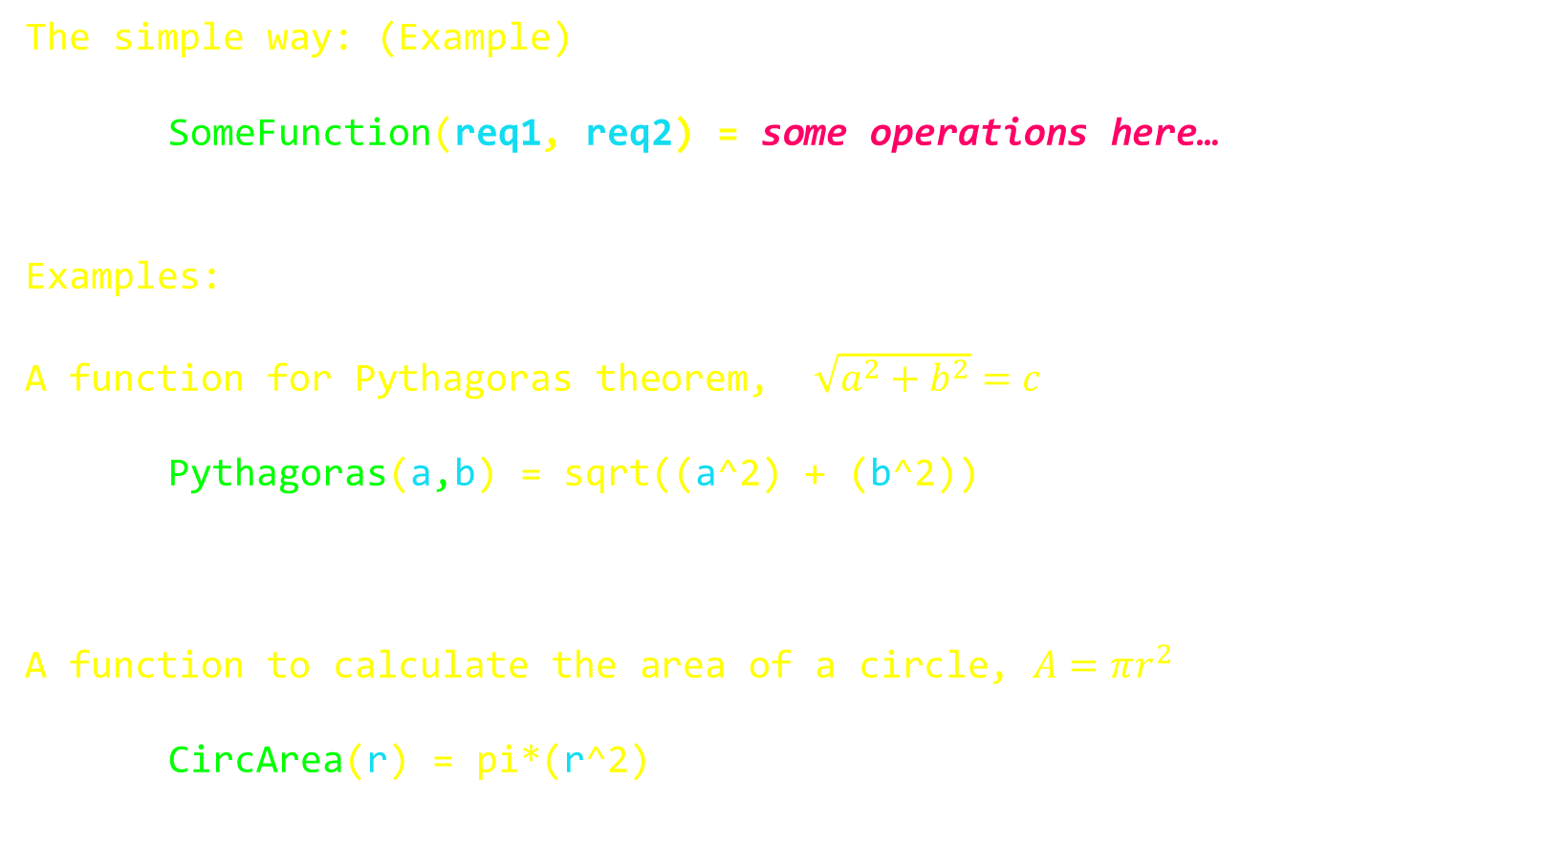
How to write functions?
One of the great things about Julia, is the way we can write simple functions!
The simple way: (Example)
SomeFunction(req1, req2) = some operations here…
Examples:
A function for Pythagoras theorem, $\sqrt{a^{2}+b^{2}}=c$
Pythagoras(a,b) = sqrt((a^2) + (b^2))
A function to calculate the area of a circle, $A=πr^{2}$
CircArea(r) = pi*(r^2)

Slide 12
How to write functions?
You can return multiple outputs too!
The simple way:
SomeFunction(req1, req2) = first operation, second operation, …
Examples:
Given a radius value, return the surface area, circumference, and volume of a sphere:
RadiusEquations(r) = 4*pi*(r^2), 2*pi*r, (4/3)*pi*(r^3)
julia> Area, Circ, Volume = RadiusEquations(5)
(314.159, 31.4159, 523.599)

Slide 13
How to write functions?
When you want to do more complex tasks, we need to write our functions the classic way.
The classic way:
function FunctionName(req1, req2)
x = sin(req1*req2/pi)^3
return x
end

Slide 14
How to write functions?
When you want to do more complex tasks, we need to write our functions the classic way.
The classic way:
function FunctionName(req1, req2; pos1, key1 = opt1, key2 = opt2)
x = sin(req1*req2/pi)^3
try x = sqrt(abs(x – pos1))
if key1 < y
…
end
end
for z = 1:key2
w = …
end
return w
end

Slide 15
How to write functions?
Example: A function to calculate car tax based on the original car price and its age. If you state the engine size, adjust the calculation accordingly. If the car has a diesel engine, lower the tax rate by 0.2.
function CarTax(price, age; enginesize, diesel = true)
rate = (price/2.4)^age
try enginesize
taxcost = rate * enginesize / 0.8
if diesel
taxcost -= 0.2
end
catch
taxcost = rate * 1.24;
end
return taxcost
end

Slide 16

One last thing about functions in Julia
Arguments passed to functions can be any type of object (Ints, Floats, Strings, Arrays, Dictionaries, Tuples, etc), even other Functions!
function Example(Data_Arg, Function_Arg)
x = floor(Data/0.74).^3
y = Function_Arg(x)
return y
end
Example: A function to normalise a data array by the standard deviation
function Normalise(Data, FunctionArg)
NormData = Data./FunctionArg(Data)
return NormData
end
julia> Data = [3.45, 6.78, 1.22, 0.33, 9.13, 3.77, 5.55, 6.46];
julia> Normalised_Data = Normalise(Data, std)
[1.16, 2.29, 0.41, 0.11, 3.08, 1.27, 1.87, 2.18]

Slide 17

Let’s have a short break here

Slide 18
Composite Types
(AKA Objects)
Composite types are to Julia what objects are to other object-oriented languages.
A composite type is simply a collection of data (variables) and methods (functions) attached under one object.
As noted earlier, object methods are different to function methods.
Function methods are the various ways that functions act depending on the type of arguments they receive.
Object methods are variables and items attached to an entity which can be manipulated and acted on.
Notes:
Reference Python and my name.

Slide 19

Composite Types
Here’s an example:
We could create a composite type called ‘Employee’.
The methods attached to that employee could be:
Name, Surname (String)
Age (Int)
Department (String)
Grants (Dictionary)
Salary (Float)
Tax Class (Char)
Notes:
HR could adopt this approach.
Link it to the new pure portal in LIH

Slide 20
How to create
composite types
struct ObjectName
fizz
buzz::Int
bop::Float
ping::Function
zap::Dict
end
julia> fieldnames(ObjectName)
(:fizz, :buzz, :bop, :ping, :zap)
julia> X = ObjectName(”fizz”, 5, 4.452, abs(), Dict(“A”=>3,”B”=>25));
julia> typeof(x)
ObjectName

Slide 21
Back to our Employee Example
struct Employee
Name::String
Age::Int
Dept::String
Grants::Dict
TaxClass::Char Salary::Float64
end
julia> fieldnames(Employee)
(:Name, :Age, :Dept, :Grants, :TaxClass, :Salary)
julia> E2347 = Employee(”Musk, Elon”, 55, “Tesla”, Dict(), ‘A’, 999999.99)
julia> typeof(E2347)
Employee
julia> E2347.Name
”Musk, Elon”
julia> E2347.Salary
999999.99
julia> E2347.Age
55

Slide 22

Problem with Structs
Standard Structs are immutable.
i.e. Once created, the object methods cannot be edited.
This is good in many cases, but can often be annoying…
However, we can overcome this by using mutable structs
Notes:
Reference Python and my name.

Slide 23
Back to our Employee Example
mutable struct Employee
Name::String
Age::Int
Dept::String
Grants::Dict
TaxClass::Char Salary::Float64
end
julia> E2347 = Employee(”Musk, Elon”, 55, “Tesla”, Dict(), ‘A’, 999999.99)
julia> typeof(E2347)
Employee
julia> E2347.Name
”Musk, Elon”
julia> E2347.Name = “Musk, Elon Reeve”
”Musk, Elon Reeve”
julia> E2347.Salary
999999.99
julia> E2347.Salary = 1000000000.00
1000000000.00

Slide 24

More info on Structs and Composite types
https://youtu.be/pHQe3PiYY1w

Slide 25
Homework Week 4:
Complete exercise sheet for Week 4
Install (if you haven’t already):
RDataSets.jl
DelimitedFiles.jl
CSV.jl
DataFrames.jl
HypothesisTests.jl
Statistics.jl
StatsBase.jl
MultivariateStats.jl
LinearAlgebra.jl
TimeSeries.jl
MAT.jl (optional)
PythonCall.jl (optional)
For Beginners!

Slide 26

Like learning a real language, the only way to become fluent is to practice.
OK, let’s start writing some code!!!

Slide 27
Some examples of this in action
As another example, let’s use the function for performing t-tests – OneSampleTTest()
julia> using HypothesisTests
julia> xdata = rand(100); ydata = rand(100) .+ 1.2
julia> OneSampleTTest()
MethodError: no method matching OneSampleTTest()
# One sample t-test of the null hypothesis that xdata comes from distribution with mean μ0 = 0
julia> OneSampleTTest(xdata)
julia> OneSampleTTest(xdata, )
julia> std(rand(20,5), , inflation_rate = 1.234)

